Slide 1

高斯混合模型

Slide 2
目录
高斯混合模型介绍
高斯混合模型

Slide 3
1. 高斯混合模型介绍
高斯混合模型介绍
高斯混合模型

Slide 4
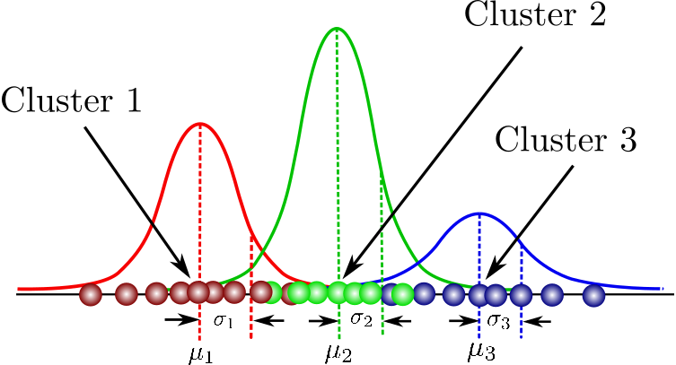
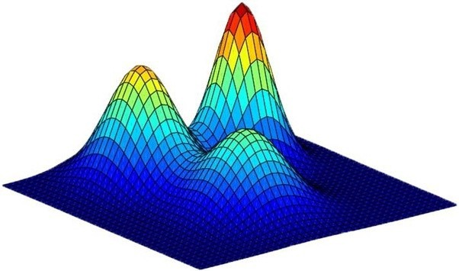
高斯混合模型
高斯混合模型（Gaussian Mixture Model, GMM）是一种聚类算法。高斯混合模型将数据中的每个簇建模为一个高斯分布。

Slide 5
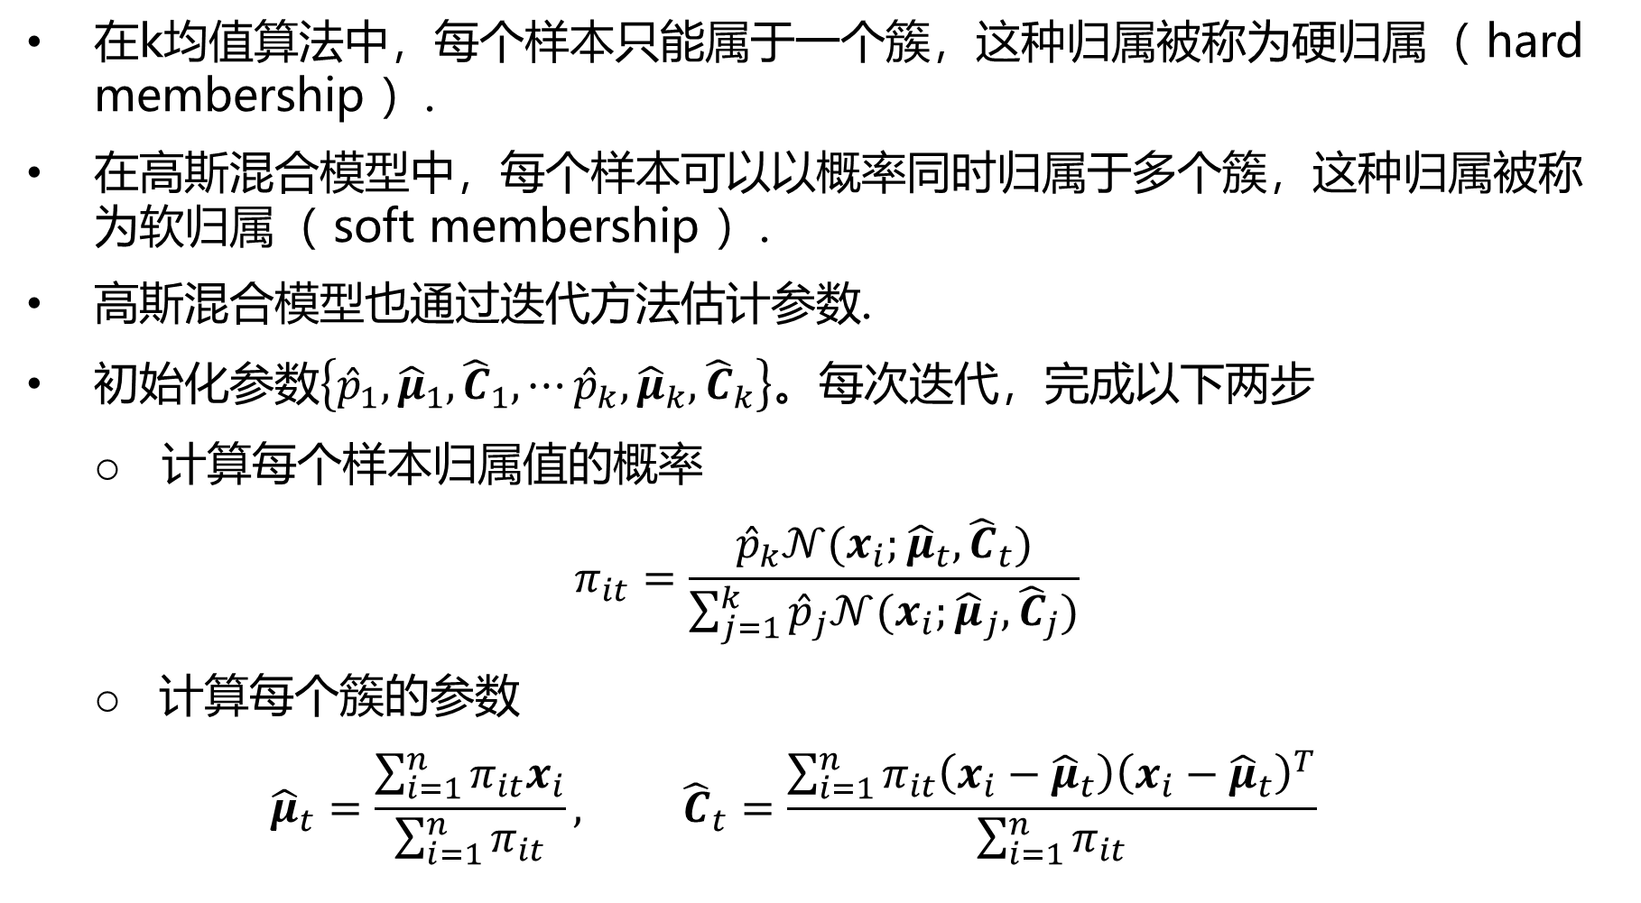
高斯混合模型
在k均值算法中，每个样本只能属于一个簇，这种归属被称为硬归属（ hard membership ）.
在高斯混合模型中，每个样本可以以概率同时归属于多个簇，这种归属被称为软归属（ soft membership ）.
高斯混合模型也通过迭代方法估计参数.
初始化参数$\left\{{\hat{p}}_{1},{\hat{μ}}_{1}, {\hat{C}}_{1},⋯{\hat{p}}_{k},{\hat{μ}}_{k}, {\hat{C}}_{k}\right\}$。每次迭代，完成以下两步
计算每个样本归属值的概率
$$π_{it}=\frac{{\hat{p}}_{k}𝒩(x_{i};{\hat{μ}}_{t},{\hat{C}}_{t})}{\sum_{j=1}^{k}{{\hat{p}}_{j}𝒩({x_{i};\hat{μ}}_{j},{\hat{C}}_{j})}}$$
计算每个簇的参数
$${\hat{μ}}_{t}=\frac{\sum_{i=1}^{n}{π_{it}x_{i}}}{\sum_{i=1}^{n}{π_{it}}}, {\hat{C}}_{t}=\frac{\sum_{i=1}^{n}{π_{it}\left(x_{i}−{\hat{μ}}_{t}\right){\left(x_{i}−{\hat{μ}}_{t}\right)}^{T}}}{\sum_{i=1}^{n}{π_{it}}}$$

Slide 6
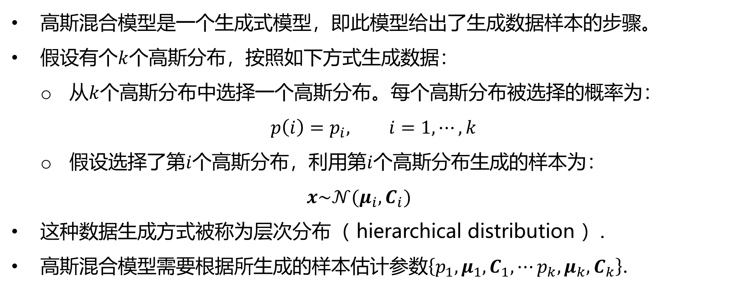
高斯混合模型
高斯混合模型是一个生成式模型，即此模型给出了生成数据样本的步骤。
假设有个$k$个高斯分布，按照如下方式生成数据：
从$k$个高斯分布中选择一个高斯分布。每个高斯分布被选择的概率为：
$$p\left(i\right)=p_{i}, i=1,⋯,k$$
假设选择了第$i$个高斯分布，利用第$i$个高斯分布生成的样本为：
$$x\sim 𝒩(μ_{i}, C_{i})$$
这种数据生成方式被称为层次分布（ hierarchical distribution ）.
高斯混合模型需要根据所生成的样本估计参数$\left\{p_{1},μ_{1}, C_{1}, ⋯p_{k},μ_{k}, C_{k}\right\}$.

Slide 7
高斯混合模型
高斯混合模型属于Expectation maximization (EM)算法的一个应用。在EM算法中，优化问题的目标函数有参数和随机变量。EM算法是一种迭代算法，在每次迭代中，进行如下两步：
E步：处理随机变量，计算随机变量的后验概率，计算目标函数对随机变量的期望.
M步：优化参数，使目标函数最大.

Slide 8


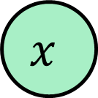
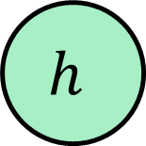
EM算法
EM算法是一个参数估计算法，适用于量测或观测量不完整情况.
在下图中，$θ$是一个参数，$x$是关于$θ$的观测值或量测值.
但仅有观测值$x$，观测是不完整的， $x$和$h$组成一个完整的观测值。但$h$未知，因此 $h$被称为隐变量（hidden variable）.
$$h$$
$$θ$$
$$x$$

Slide 9

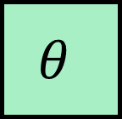

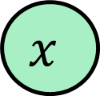
EM算法
但仅有$x$，观测是不完整的， $x$和$h$组成一个完整观测值。但$h$未知。
之所以称“观测不完整”，是因为根据已有的观测，难以通过最大似然估计参数，
$$\max_{θ}p(x;θ)$$
如果有完整观测$x$和$h$，使用最大似然估计可以估计参数，即
$\max_{θ}p(x,h;θ)$ 或者 $\max_{θ}log(p(x,h;θ))$
$$h$$
$$θ$$
$$x$$

Slide 10
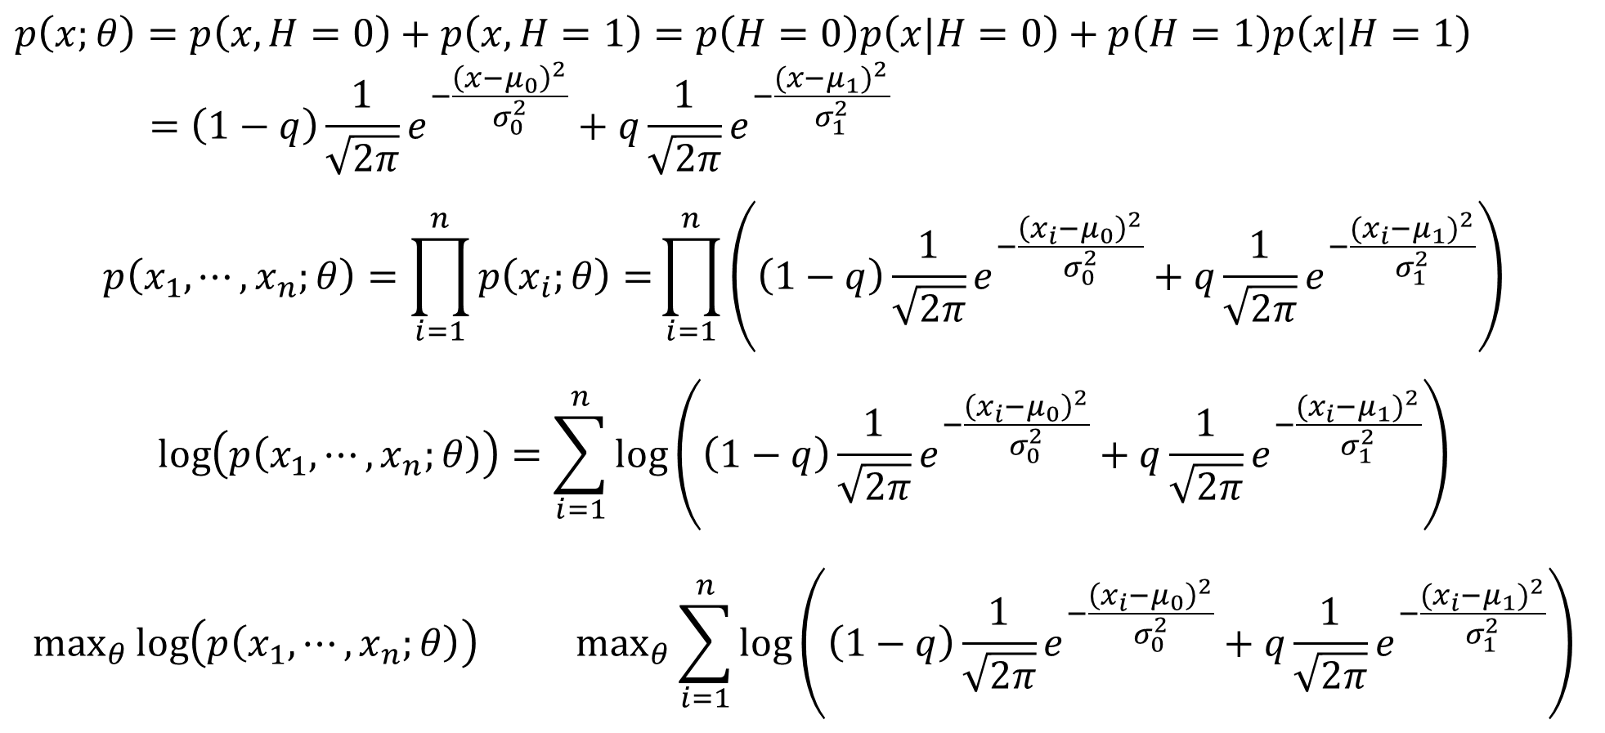
EM算法
$$p\left(x;θ\right)=p\left(x,H=0\right)+p\left(x,H=1\right)=p\left(H=0\right)p\left(x|H=0\right)+p\left(H=1\right)p\left(x|H=1\right)$$
$$=\left(1−q\right)\frac{1}{\sqrt{2π}}e^{−\frac{{\left(x−μ_{0}\right)}^{2}}{σ_{0}^{2}}}+q\frac{1}{\sqrt{2π}}e^{−\frac{{(x−μ_{1})}^{2}}{σ_{1}^{2}}}$$
$$p\left(x_{1}, ⋯,x_{n};θ\right)=\prod_{i=1}^{n}{p\left(x_{i};θ\right)=}\prod_{i=1}^{n}{\left(\left(1−q\right)\frac{1}{\sqrt{2π}}e^{−\frac{{\left(x_{i}−μ_{0}\right)}^{2}}{σ_{0}^{2}}}+q\frac{1}{\sqrt{2π}}e^{−\frac{{(x_{i}−μ_{1})}^{2}}{σ_{1}^{2}}}\right)}$$
$$\log\left(p\left(x_{1}, ⋯,x_{n};θ\right)\right)=\sum_{i=1}^{n}{log\left(\left(1−q\right)\frac{1}{\sqrt{2π}}e^{−\frac{{\left(x_{i}−μ_{0}\right)}^{2}}{σ_{0}^{2}}}+q\frac{1}{\sqrt{2π}}e^{−\frac{{(x_{i}−μ_{1})}^{2}}{σ_{1}^{2}}}\right)}$$
$$\max_{θ}\log\left(p\left(x_{1}, ⋯,x_{n};θ\right)\right) \max_{θ}\sum_{i=1}^{n}{log\left(\left(1−q\right)\frac{1}{\sqrt{2π}}e^{−\frac{{\left(x_{i}−μ_{0}\right)}^{2}}{σ_{0}^{2}}}+q\frac{1}{\sqrt{2π}}e^{−\frac{{(x_{i}−μ_{1})}^{2}}{σ_{1}^{2}}}\right)}$$

Slide 11
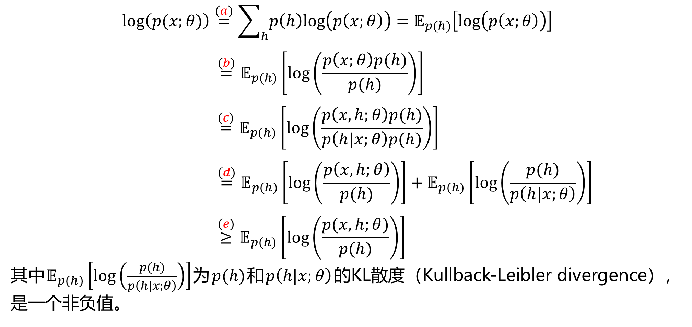
EM算法
$$log\left(p(x;θ)\right)\overset{(a)}{=}\sum_{h}{p\left(h\right)log\left(p\left(x;θ\right)\right)}=𝔼_{p(h)}\left[log\left(p\left(x;θ\right)\right)\right]$$
$$\overset{(b)}{=}𝔼_{p(h)}\left[log\left(\frac{p\left(x;θ\right)p(h)}{p(h)}\right)\right]$$
$$\overset{(c)}{=}𝔼_{p(h)}\left[log\left(\frac{p\left(x, h;θ\right)p(h)}{p\left(h|x;θ\right)p(h)}\right)\right]$$
$$\overset{(d)}{=}𝔼_{p(h)}\left[log\left(\frac{p\left(x, h;θ\right)}{p(h)}\right)\right]+𝔼_{p(h)}\left[log\left(\frac{p(h)}{p\left(h|x;θ\right)}\right)\right]$$
$$\overset{(e)}{≥}𝔼_{p(h)}\left[log\left(\frac{p(x,h;θ)}{p(h)}\right)\right]$$
其中$𝔼_{p(h)}\left[log\left(\frac{p(h)}{p\left(h|x;θ\right)}\right)\right]$为$p(h)$和$p\left(h|x;θ\right)$的KL散度（Kullback-Leibler divergence），是一个非负值。

Slide 12
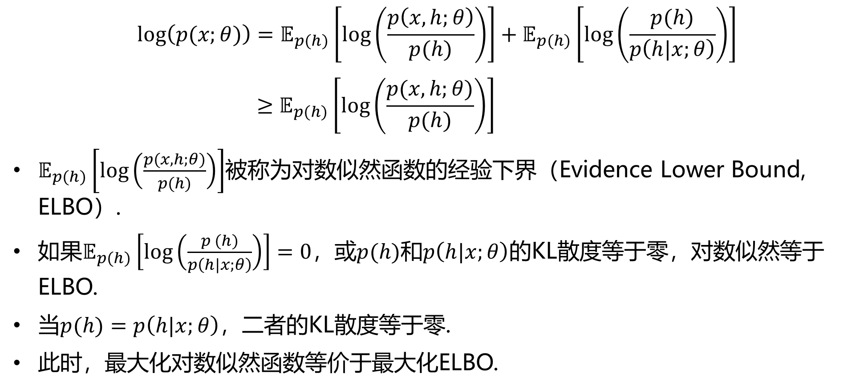
EM算法
$$log\left(p(x;θ)\right)=𝔼_{p(h)}\left[log\left(\frac{p\left(x, h;θ\right)}{p(h)}\right)\right]+𝔼_{p(h)}\left[log\left(\frac{p(h)}{p\left(h|x;θ\right)}\right)\right]$$
$$≥𝔼_{p(h)}\left[log\left(\frac{p(x,h;θ)}{p(h)}\right)\right]$$
$𝔼_{p(h)}\left[log\left(\frac{p(x,h;θ)}{p(h)}\right)\right]$被称为对数似然函数的经验下界（Evidence Lower Bound, ELBO）.
如果$𝔼_{p(h)}\left[log\left(\frac{p (h)}{p\left(h|x;θ\right)}\right)\right]=0$，或$p(h)$和$p\left(h|x;θ\right)$的KL散度等于零，对数似然等于ELBO.
当$p(h)=p\left(h|x;θ\right)$，二者的KL散度等于零.
此时，最大化对数似然函数等价于最大化ELBO.

Slide 13
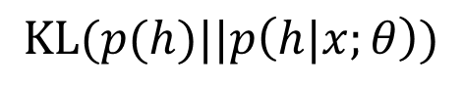
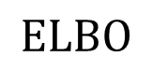
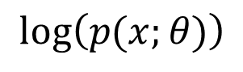
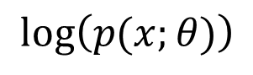
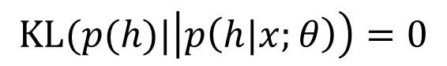
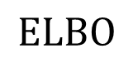
EM算法
$$log\left(p(x;θ)\right)$$
$$log\left(p(x;θ)\right)$$
$$KL(p(h)||p\left(h|x;θ\right))$$
$$KL(p(h)|\left|p\left(h|x;θ\right)\right)=0$$
$$ELBO$$
$$ELBO$$

Slide 14
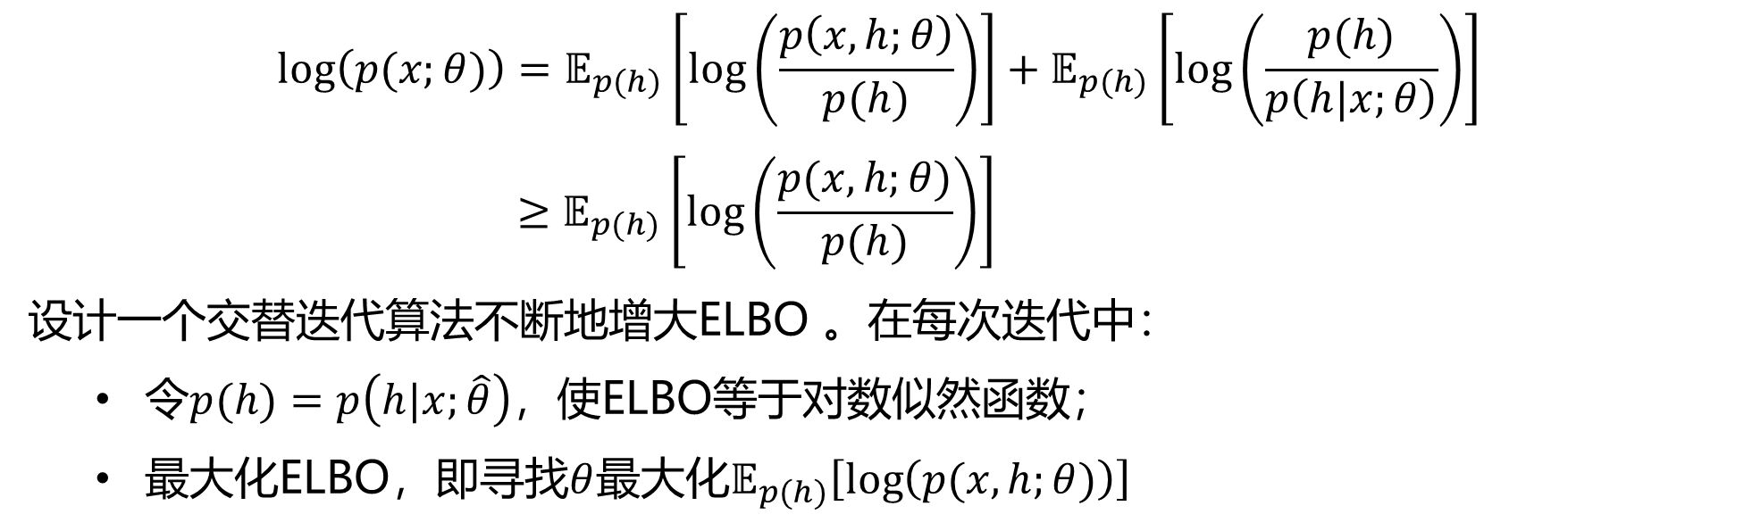
EM算法
$$log\left(p(x;θ)\right)=𝔼_{p(h)}\left[log\left(\frac{p\left(x, h;θ\right)}{p(h)}\right)\right]+𝔼_{p(h)}\left[log\left(\frac{p(h)}{p\left(h|x;θ\right)}\right)\right]$$
$$≥𝔼_{p(h)}\left[log\left(\frac{p(x,h;θ)}{p(h)}\right)\right]$$
设计一个交替迭代算法不断地增大ELBO 。在每次迭代中：
令$p(h)=p\left(h|x;\hat{θ}\right)$，使ELBO等于对数似然函数；
最大化ELBO，即寻找$θ$最大化$𝔼_{p(h)}\left[log\left(p(x,h;θ)\right)\right]$

Slide 15
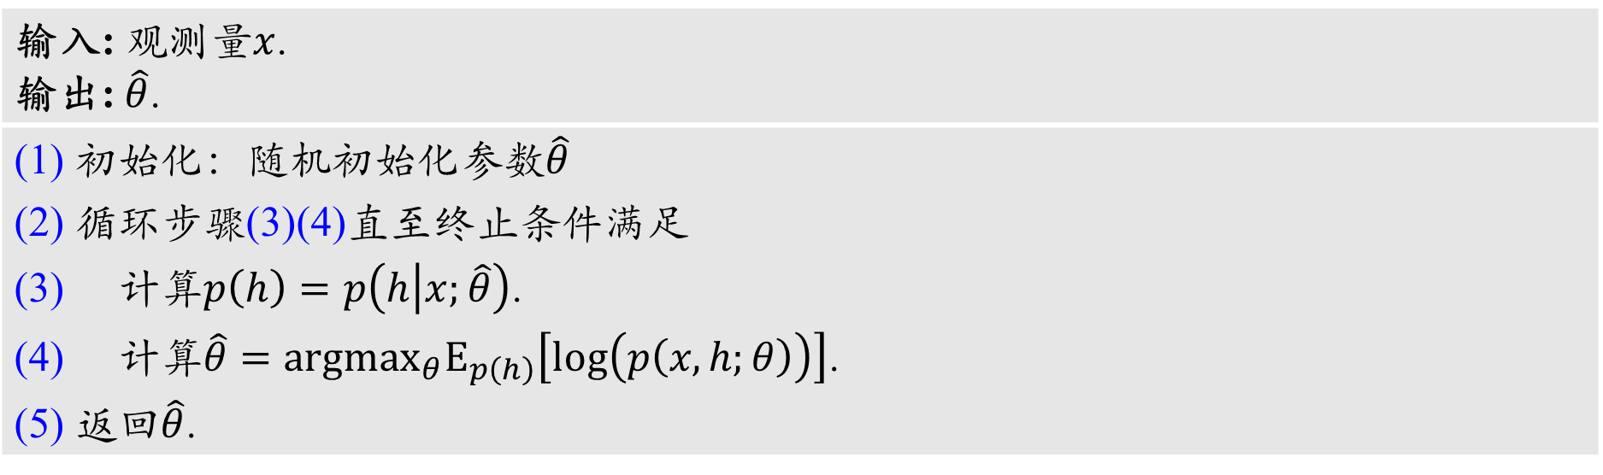
EM算法
EM算法伪代码
输入: 观测量$x$. 输出: $\hat{θ}$.
(1) 初始化：随机初始化参数$\hat{θ}$ (2) 循环步骤(3)(4)直至终止条件满足 (3) 计算$p\left(h\right)=p\left(h | x;\hat{θ}\right)$. (4) 计算$\hat{θ}={argmax}_{θ}E_{p\left(h\right)}\left[log\left(p\left(x,h;θ\right)\right)\right]$. (5) 返回$\hat{θ}$.

Slide 16
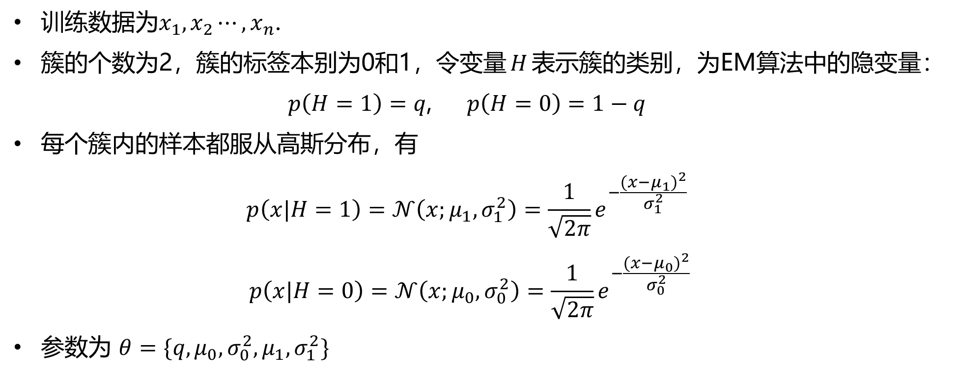
EM算法
训练数据为$x_{1},x_{2}⋯,x_{n}$.
簇的个数为2，簇的标签本别为0和1，令变量$H$表示簇的类别，为EM算法中的隐变量：
$p\left(H=1\right)=q$, $p\left(H=0\right)=1−q$
每个簇内的样本都服从高斯分布，有
$$p\left(x|H=1\right)=𝒩\left(x;μ_{1},σ_{1}^{2}\right)=\frac{1}{\sqrt{2π}}e^{−\frac{{(x−μ_{1})}^{2}}{σ_{1}^{2}}}$$
$$p\left(x|H=0\right)=𝒩\left(x;μ_{0},σ_{0}^{2}\right)=\frac{1}{\sqrt{2π}}e^{−\frac{{(x−μ_{0})}^{2}}{σ_{0}^{2}}}$$
参数为 $θ=\{q,μ_{0},σ_{0}^{2},μ_{1},σ_{1}^{2}\}$

Slide 17
高斯混合模型
EM算法伪代码
输入: 观测量$x$. 输出: $\hat{θ}$.
(1) 初始化：随机初始化参数$\hat{θ}$ (2) 循环步骤(3)(4)直至终止条件满足 (3) 计算$p\left(h\right)=p\left(h | x;\hat{θ}\right)$. (4) 计算$\hat{θ}={argmax}_{θ}E_{p\left(h\right)}\left[log\left(p\left(x,h;θ\right)\right)\right]$. (5) 返回$\hat{θ}$.

Slide 18
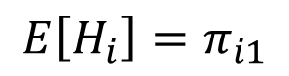
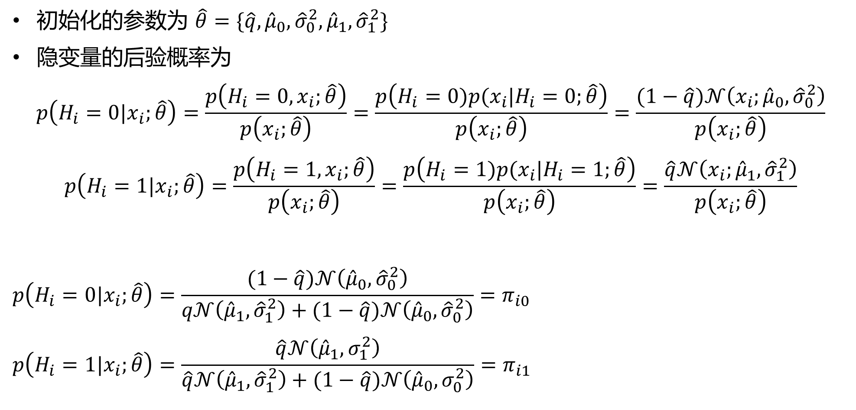
高斯混合模型
初始化的参数为 $\hat{θ}=\{\hat{q}, {\hat{μ}}_{0}, {\hat{σ}}_{0}^{2}, {\hat{μ}}_{1}, {\hat{σ}}_{1}^{2}\}$
隐变量的后验概率为
$$p\left(H_{i}=0|x_{i};\hat{θ}\right)=\frac{p\left(H_{i}=0,x_{i};\hat{θ}\right)}{p\left(x_{i};\hat{θ}\right)}=\frac{p\left(H_{i}=0)p(x_{i}|H_{i}=0;\hat{θ}\right)}{p\left(x_{i};\hat{θ}\right)}=\frac{(1−\hat{q})𝒩\left(x_{i};{\hat{μ}}_{0}, {\hat{σ}}_{0}^{2}\right)}{p\left(x_{i};\hat{θ}\right)}$$
$$p\left(H_{i}=1|x_{i};\hat{θ}\right)=\frac{p\left(H_{i}=1,x_{i};\hat{θ}\right)}{p\left(x_{i};\hat{θ}\right)}=\frac{p\left(H_{i}=1)p(x_{i}|H_{i}=1;\hat{θ}\right)}{p\left(x_{i};\hat{θ}\right)}=\frac{\hat{q}𝒩\left(x_{i};{\hat{μ}}_{1}, {\hat{σ}}_{1}^{2}\right)}{p\left(x_{i};\hat{θ}\right)}$$
$$p\left(H_{i}=0|x_{i};\hat{θ}\right)=\frac{(1−\hat{q})𝒩\left({\hat{μ}}_{0}, {\hat{σ}}_{0}^{2}\right)}{q𝒩\left({\hat{μ}}_{1}, {\hat{σ}}_{1}^{2}\right)+(1−\hat{q})𝒩\left({\hat{μ}}_{0}, {\hat{σ}}_{0}^{2}\right)}=π_{i0}$$
$$p\left(H_{i}=1|x_{i};\hat{θ}\right)=\frac{\hat{q}𝒩\left({\hat{μ}}_{1},σ_{1}^{2}\right)}{\hat{q}𝒩\left({\hat{μ}}_{1}, {\hat{σ}}_{1}^{2}\right)+(1−\hat{q})𝒩\left({\hat{μ}}_{0},σ_{0}^{2}\right)}=π_{i1}$$
$$E\left[H_{i}\right]=π_{i1}$$

Slide 19
高斯混合模型
EM算法伪代码
输入: 观测量$x$. 输出: $\hat{θ}$.
(1) 初始化：随机初始化参数$\hat{θ}$ (2) 循环步骤(3)(4)直至终止条件满足 (3) 计算$p\left(h\right)=p\left(h | x;\hat{θ}\right)$. (4) 计算$\hat{θ}={argmax}_{θ}E_{p\left(h\right)}\left[log\left(p\left(x,h;θ\right)\right)\right]$. (5) 返回$\hat{θ}$.

Slide 20
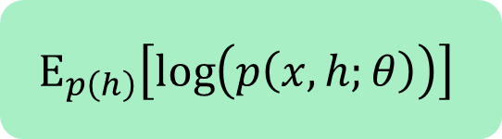
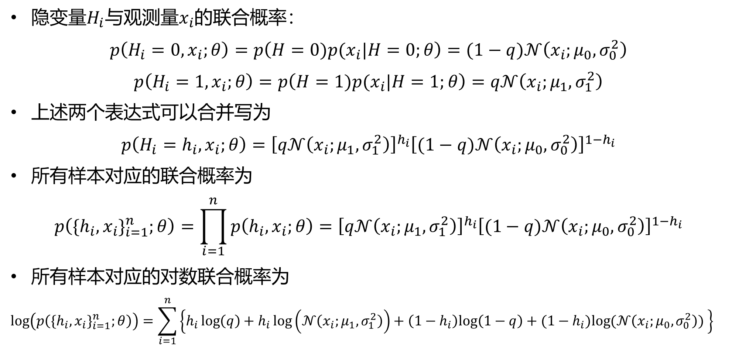
高斯混合模型
$$E_{p\left(h\right)}\left[log\left(p\left(x,h;θ\right)\right)\right]$$
隐变量$H_{i}$与观测量$x_{i}$的联合概率：
$$p\left(H_{i}=0, x_{i};θ\right)=p\left(H=0)p(x_{i}|H=0;θ\right)=(1−q)𝒩\left(x_{i};μ_{0},σ_{0}^{2}\right)$$
$$p\left(H_{i}=1, x_{i};θ\right)=p\left(H=1)p(x_{i}|H=1;θ\right)=q𝒩\left(x_{i};μ_{1},σ_{1}^{2}\right)$$
上述两个表达式可以合并写为
$$p\left(H_{i}=h_{i}, x_{i};θ\right)={\left[q𝒩\left(x_{i};μ_{1},σ_{1}^{2}\right)\right]}^{h_{i}}{\left[(1−q)𝒩\left(x_{i};μ_{0},σ_{0}^{2}\right)\right]}^{1−h_{i}}$$
所有样本对应的联合概率为
$$p\left({\{h_{i},x_{i}\}}_{i=1}^{n};θ\right)=\prod_{i=1}^{n}{p\left(h_{i}, x_{i};θ\right)}={\left[q𝒩\left(x_{i};μ_{1},σ_{1}^{2}\right)\right]}^{h_{i}}{\left[(1−q)𝒩\left(x_{i};μ_{0},σ_{0}^{2}\right)\right]}^{1−h_{i}}$$
所有样本对应的对数联合概率为
$$log\left(p\left({\{h_{i},x_{i}\}}_{i=1}^{n};θ\right)\right)=\sum_{i=1}^{n}{\left\{h_{i}\log\left(q\right)+h_{i}\log\left(𝒩\left(x_{i};μ_{1},σ_{1}^{2}\right)\right)+\left(1−h_{i}\right)log\left(1−q\right)+(1−h_{i})log⁡(𝒩\left(x_{i};μ_{0},σ_{0}^{2}\right)) \right\}}$$

Slide 21
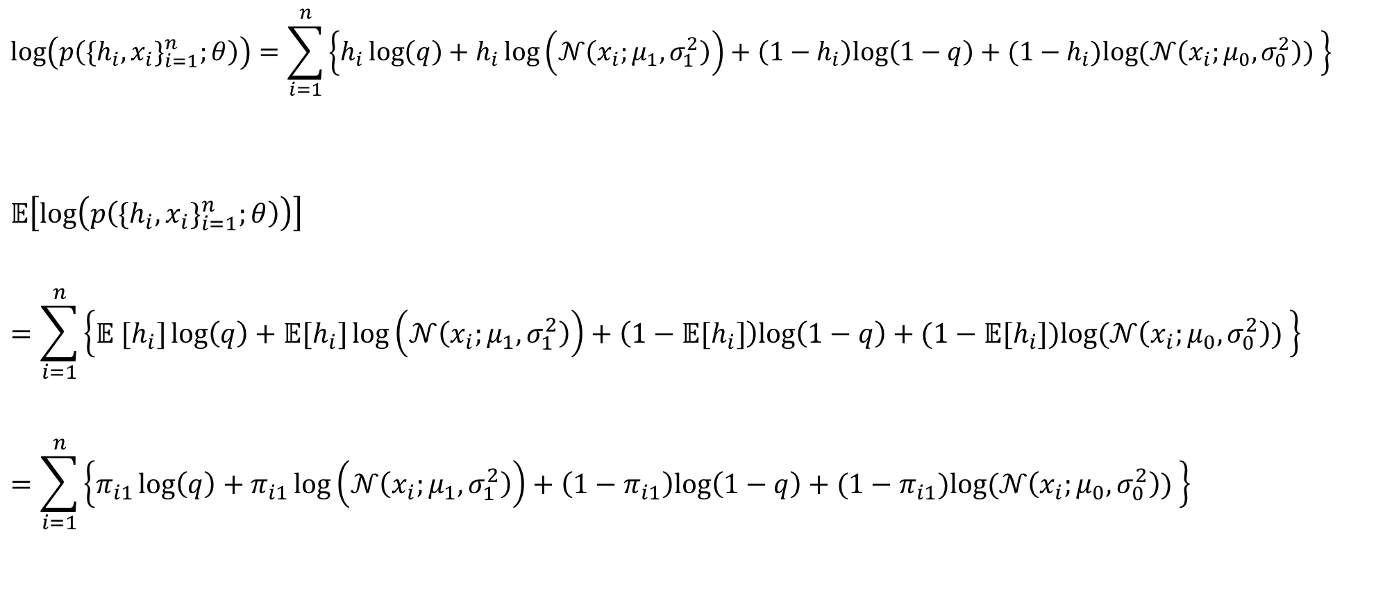
高斯混合模型
$$E_{p\left(h\right)}\left[log\left(p\left(x,h;θ\right)\right)\right]$$
$$log\left(p\left({\{h_{i},x_{i}\}}_{i=1}^{n};θ\right)\right)=\sum_{i=1}^{n}{\left\{h_{i}\log\left(q\right)+h_{i}\log\left(𝒩\left(x_{i};μ_{1},σ_{1}^{2}\right)\right)+\left(1−h_{i}\right)log\left(1−q\right)+(1−h_{i})log⁡(𝒩\left(x_{i};μ_{0},σ_{0}^{2}\right)) \right\}}$$
$$𝔼\left[log\left(p\left({\{h_{i},x_{i}\}}_{i=1}^{n};θ\right)\right)\right]=\sum_{i=1}^{n}{\left\{{𝔼 [h}_{i}]\log\left(q\right)+{𝔼[h}_{i}]\log\left(𝒩\left(x_{i};μ_{1},σ_{1}^{2}\right)\right)+\left(1−{𝔼[h}_{i}]\right)log\left(1−q\right)+(1−{𝔼[h}_{i}])log⁡(𝒩\left(x_{i};μ_{0},σ_{0}^{2}\right)) \right\}}$$
$$=\sum_{i=1}^{n}{\left\{π_{i1}\log\left(q\right)+π_{i1}\log\left(𝒩\left(x_{i};μ_{1},σ_{1}^{2}\right)\right)+\left(1−π_{i1}\right)log\left(1−q\right)+(1−π_{i1})log⁡(𝒩\left(x_{i};μ_{0},σ_{0}^{2}\right)) \right\}}$$

Slide 22
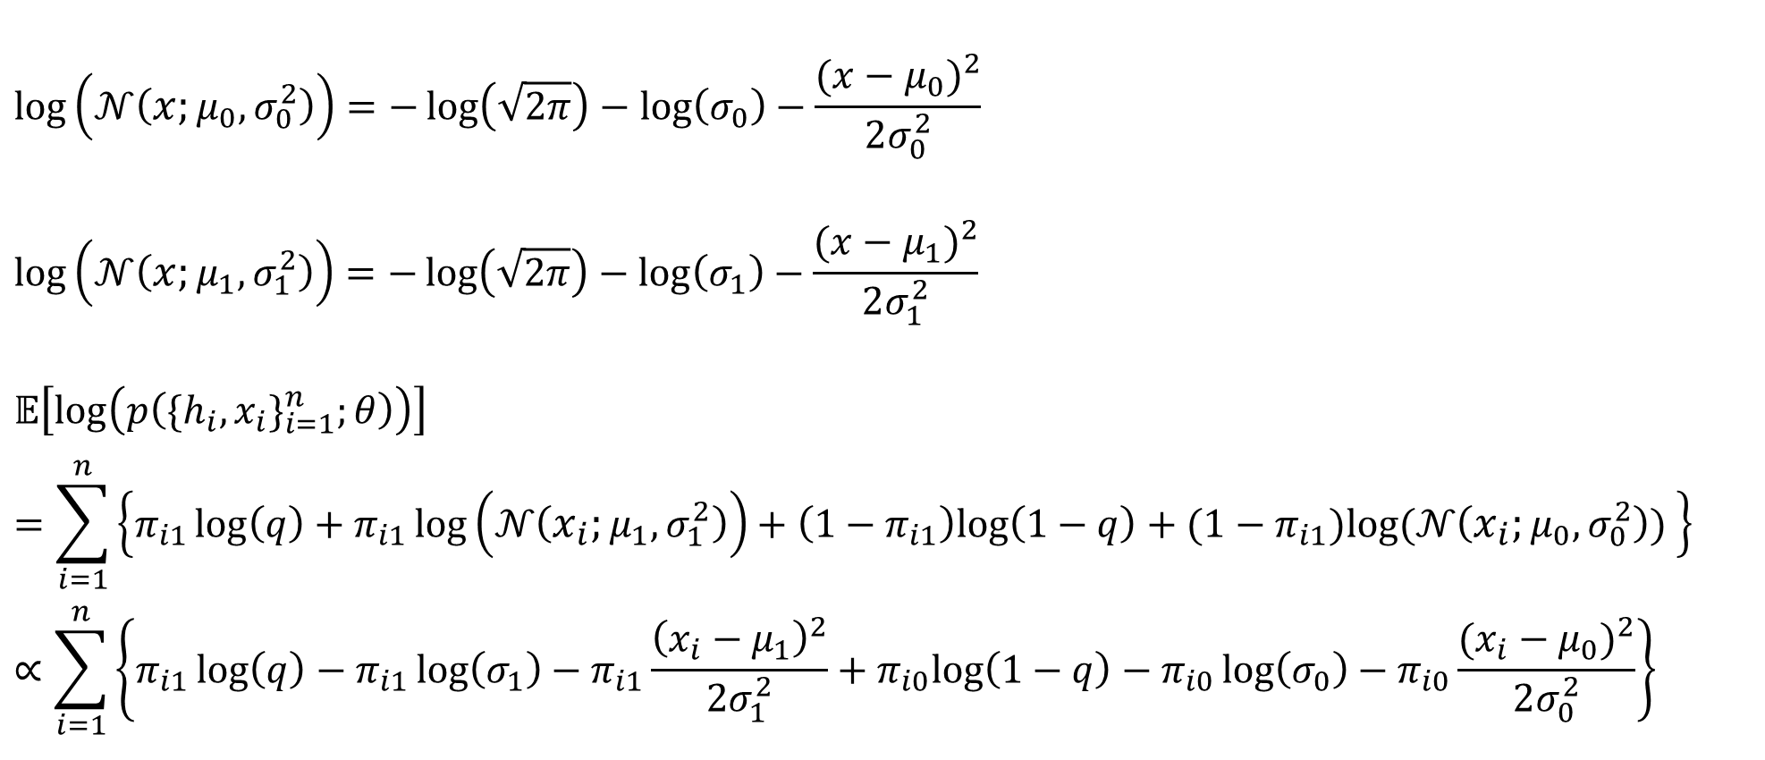
高斯混合模型
$$E_{p\left(h\right)}\left[log\left(p\left(x,h;θ\right)\right)\right]$$
$$log\left(𝒩\left(x;μ_{0},σ_{0}^{2}\right)\right)=−\log\left(\sqrt{2π}\right)−\log\left(σ_{0}\right)−\frac{{(x−μ_{0})}^{2}}{2σ_{0}^{2}}$$
$$log\left(𝒩\left(x;μ_{1},σ_{1}^{2}\right)\right)=−\log\left(\sqrt{2π}\right)−\log\left(σ_{1}\right)−\frac{{(x−μ_{1})}^{2}}{2σ_{1}^{2}}$$
$$𝔼\left[log\left(p\left({\{h_{i},x_{i}\}}_{i=1}^{n};θ\right)\right)\right]$$
$$=\sum_{i=1}^{n}{\left\{π_{i1}\log\left(q\right)+π_{i1}\log\left(𝒩\left(x_{i};μ_{1},σ_{1}^{2}\right)\right)+\left(1−π_{i1}\right)log\left(1−q\right)+(1−π_{i1})log⁡(𝒩\left(x_{i};μ_{0},σ_{0}^{2}\right)) \right\}}$$
$$∝\sum_{i=1}^{n}{\left\{π_{i1}\log\left(q\right)−π_{i1}\log\left(σ_{1}\right)−π_{i1}\frac{{\left(x_{i}−μ_{1}\right)}^{2}}{2σ_{1}^{2}}+π_{i0}log\left(1−q\right)−π_{i0}\log\left(σ_{0}\right)−π_{i0}\frac{{(x_{i}−μ_{0})}^{2}}{2σ_{0}^{2}}\right\}}$$

Slide 23
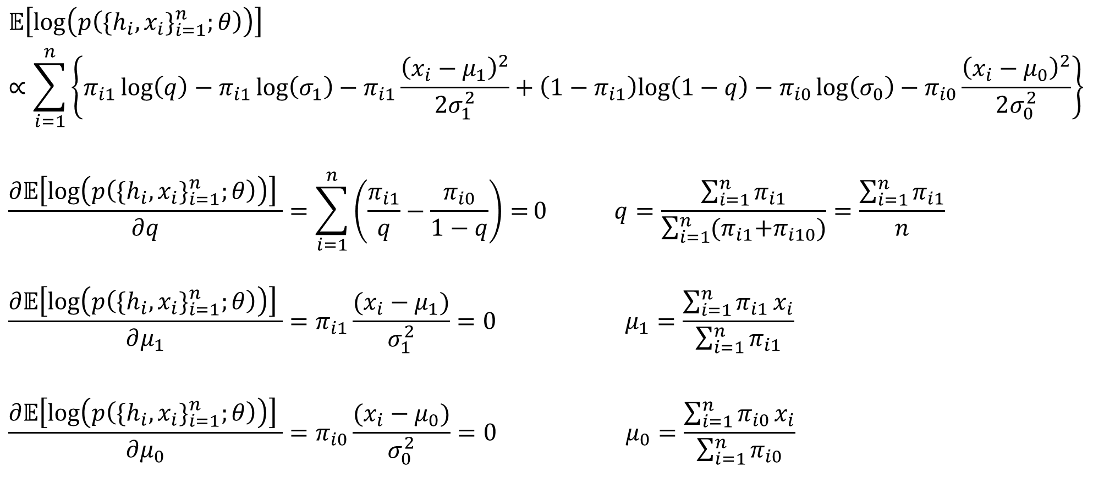
高斯混合模型
$$E_{p\left(h\right)}\left[log\left(p\left(x,h;θ\right)\right)\right]$$
$$𝔼\left[log\left(p\left({\{h_{i},x_{i}\}}_{i=1}^{n};θ\right)\right)\right]$$
$$∝\sum_{i=1}^{n}{\left\{π_{i1}\log\left(q\right)−π_{i1}\log\left(σ_{1}\right)−π_{i1}\frac{{\left(x_{i}−μ_{1}\right)}^{2}}{2σ_{1}^{2}}+\left(1−π_{i1}\right)log\left(1−q\right)−π_{i0}\log\left(σ_{0}\right)−π_{i0}\frac{{\left(x_{i}−μ_{0}\right)}^{2}}{2σ_{0}^{2}}\right\}}$$
$$\frac{∂𝔼\left[log\left(p\left({\{h_{i},x_{i}\}}_{i=1}^{n};θ\right)\right)\right] }{∂q}=\sum_{i=1}^{n}{\left(\frac{π_{i1}}{q}−\frac{π_{i0}}{1−q}\right)=}0 q=\frac{\sum_{i=1}^{n}{π_{i1}}}{\sum_{i=1}^{n}{{(π}_{i1}+π_{i10})}}=\frac{\sum_{i=1}^{n}{π_{i1}}}{n}$$
$$\frac{∂𝔼\left[log\left(p\left({\{h_{i},x_{i}\}}_{i=1}^{n};θ\right)\right)\right] }{∂μ_{1}}=π_{i1}\frac{(x_{i}−μ_{1})}{σ_{1}^{2}}=0 μ_{1}=\frac{\sum_{i=1}^{n}{π_{i1}}x_{i}}{\sum_{i=1}^{n}{π_{i1}}}$$
$$\frac{∂𝔼\left[log\left(p\left({\{h_{i},x_{i}\}}_{i=1}^{n};θ\right)\right)\right] }{∂μ_{0}}=π_{i0}\frac{(x_{i}−μ_{0})}{σ_{0}^{2}}=0 μ_{0}=\frac{\sum_{i=1}^{n}{π_{i0}}x_{i}}{\sum_{i=1}^{n}{π_{i0}}}$$

Slide 24
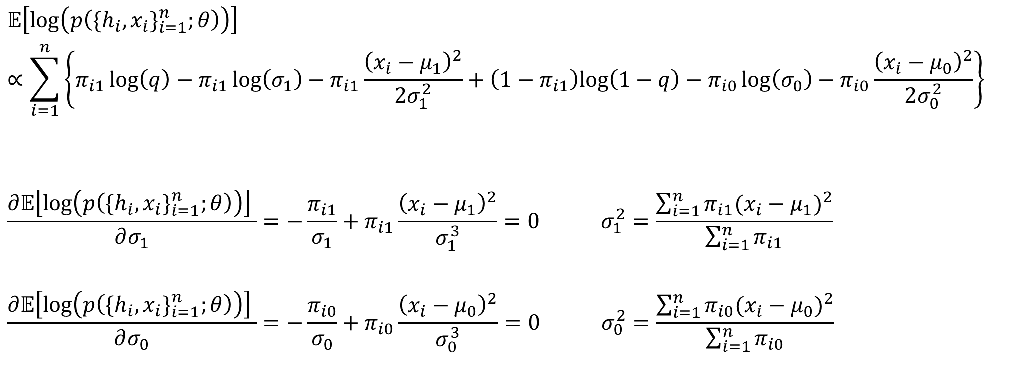
高斯混合模型
$$E_{p\left(h\right)}\left[log\left(p\left(x,h;θ\right)\right)\right]$$
$$𝔼\left[log\left(p\left({\{h_{i},x_{i}\}}_{i=1}^{n};θ\right)\right)\right]$$
$$∝\sum_{i=1}^{n}{\left\{π_{i1}\log\left(q\right)−π_{i1}\log\left(σ_{1}\right)−π_{i1}\frac{{\left(x_{i}−μ_{1}\right)}^{2}}{2σ_{1}^{2}}+\left(1−π_{i1}\right)log\left(1−q\right)−π_{i0}\log\left(σ_{0}\right)−π_{i0}\frac{{\left(x_{i}−μ_{0}\right)}^{2}}{2σ_{0}^{2}}\right\}}$$
$$\frac{∂𝔼\left[log\left(p\left({\{h_{i},x_{i}\}}_{i=1}^{n};θ\right)\right)\right] }{∂σ_{1}}=−\frac{π_{i1}}{σ_{1}}+π_{i1}\frac{{\left(x_{i}−μ_{1}\right)}^{2}}{σ_{1}^{3}}=0 σ_{1}^{2}=\frac{\sum_{i=1}^{n}{π_{i1}{(x_{i}−μ_{1})}^{2}}}{\sum_{i=1}^{n}{π_{i1}}}$$
$$\frac{∂𝔼\left[log\left(p\left({\{h_{i},x_{i}\}}_{i=1}^{n};θ\right)\right)\right] }{∂σ_{0}}=−\frac{π_{i0}}{σ_{0}}+π_{i0}\frac{{\left(x_{i}−μ_{0}\right)}^{2}}{σ_{0}^{3}}=0 σ_{0}^{2}=\frac{\sum_{i=1}^{n}{π_{i0}{(x_{i}−μ_{0})}^{2}}}{\sum_{i=1}^{n}{π_{i0}}}$$

Slide 25
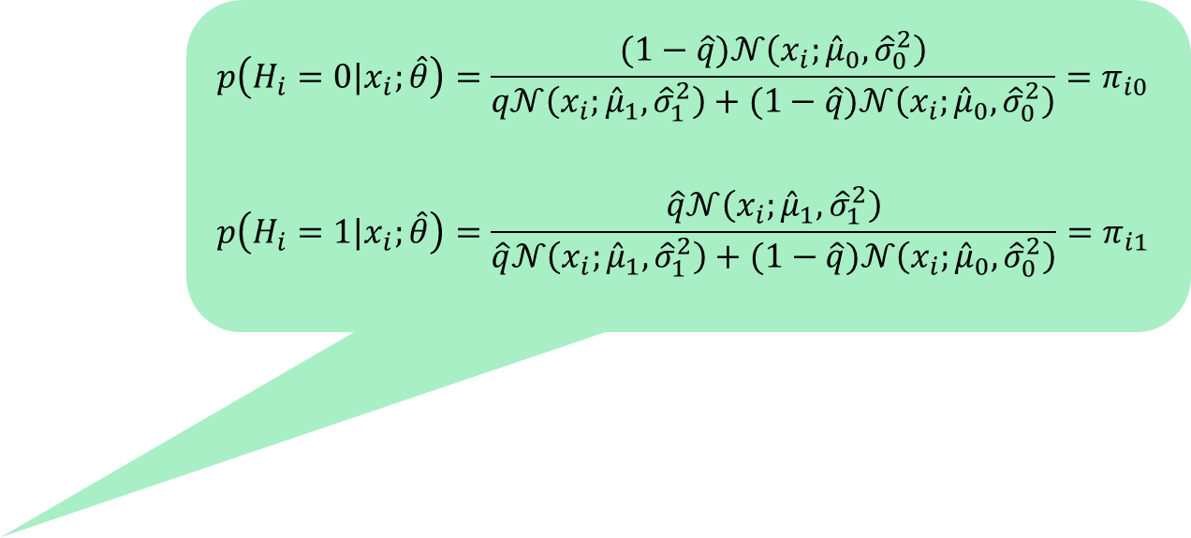
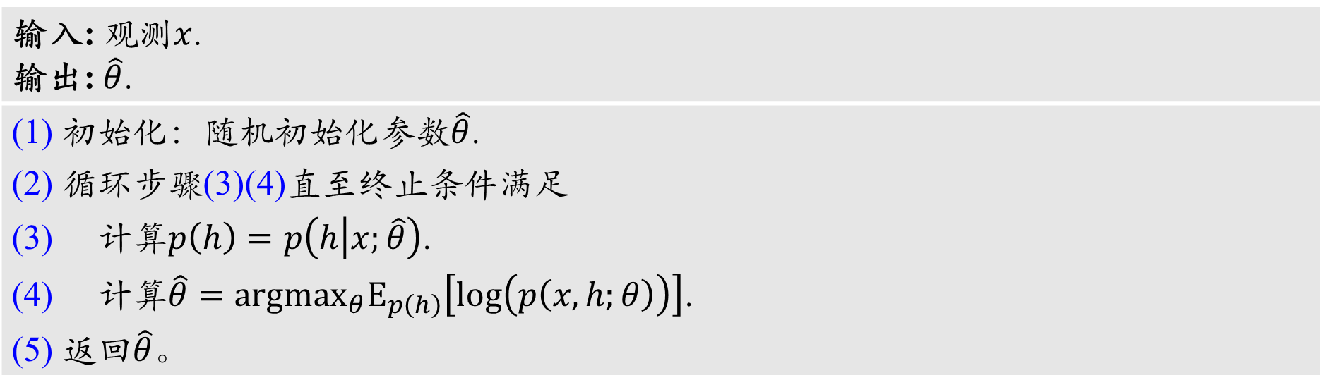
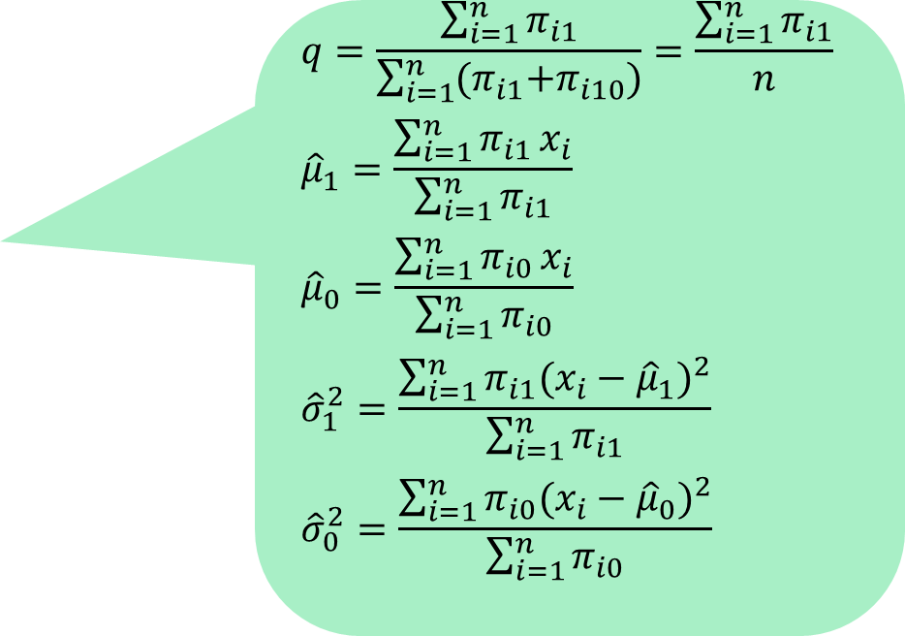
高斯混合模型
$$p\left(H_{i}=0|x_{i};\hat{θ}\right)=\frac{(1−\hat{q})𝒩\left(x_{i};{\hat{μ}}_{0}, {\hat{σ}}_{0}^{2}\right)}{q𝒩\left({x_{i};\hat{μ}}_{1}, {\hat{σ}}_{1}^{2}\right)+(1−\hat{q})𝒩\left(x_{i};{\hat{μ}}_{0}, {\hat{σ}}_{0}^{2}\right)}=π_{i0}$$
$$p\left(H_{i}=1|x_{i};\hat{θ}\right)=\frac{\hat{q}𝒩\left(x_{i};{\hat{μ}}_{1},{\hat{σ}}_{1}^{2}\right)}{\hat{q}𝒩\left(x_{i};{\hat{μ}}_{1}, {\hat{σ}}_{1}^{2}\right)+(1−\hat{q})𝒩\left(x_{i};{\hat{μ}}_{0},{\hat{σ}}_{0}^{2}\right)}=π_{i1}$$
高斯混合模型算法
输入: 观测$x$. 输出: $\hat{θ}$.
(1) 初始化：随机初始化参数$\hat{θ}$. (2) 循环步骤(3)(4)直至终止条件满足 (3) 计算$p\left(h\right)=p\left(h | x;\hat{θ}\right)$. (4) 计算$\hat{θ}={argmax}_{θ}E_{p\left(h\right)}\left[log\left(p\left(x,h;θ\right)\right)\right]$. (5) 返回$\hat{θ}$。
$$q=\frac{\sum_{i=1}^{n}{π_{i1}}}{\sum_{i=1}^{n}{{(π}_{i1}+π_{i10})}}=\frac{\sum_{i=1}^{n}{π_{i1}}}{n}$$
$${\hat{μ}}_{1}=\frac{\sum_{i=1}^{n}{π_{i1}}x_{i}}{\sum_{i=1}^{n}{π_{i1}}}$$
$${\hat{μ}}_{0}=\frac{\sum_{i=1}^{n}{π_{i0}}x_{i}}{\sum_{i=1}^{n}{π_{i0}}}$$
$${\hat{σ}}_{1}^{2}=\frac{\sum_{i=1}^{n}{π_{i1}{(x_{i}−{\hat{μ}}_{1})}^{2}}}{\sum_{i=1}^{n}{π_{i1}}}$$
$${\hat{σ}}_{0}^{2}=\frac{\sum_{i=1}^{n}{π_{i0}{(x_{i}−{\hat{μ}}_{0})}^{2}}}{\sum_{i=1}^{n}{π_{i0}}}$$

Slide 26

高斯混合模型
有两枚硬币，抛一次硬币，正面朝上的概率分别为$θ_{A}$、$θ_{B}$；
重复以下步骤五次：每次首先随机（等概率）从两枚硬币中选择一枚硬币，然后抛硬币十次，得到十个结果
H | T | T | T | H | H | T | H | T | H
H | H | H | H | T | H | H | H | H | H
H | T | H | H | H | H | H | T | H | H
H | T | H | T | T | T | H | H | T | T
T | H | H | H | T | H | H | H | T | H
Do, C., Batzoglou, S. What is the expectation maximization algorithm?. Nat Biotechnol 26, 897–899 (2008).

Slide 27
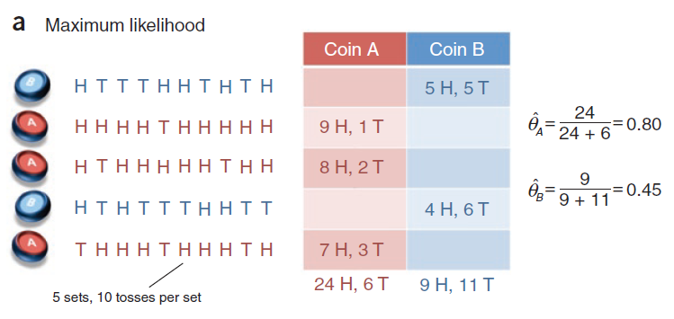
高斯混合模型
Do, C., Batzoglou, S. What is the expectation maximization algorithm?. Nat Biotechnol 26, 897–899 (2008).

Slide 28
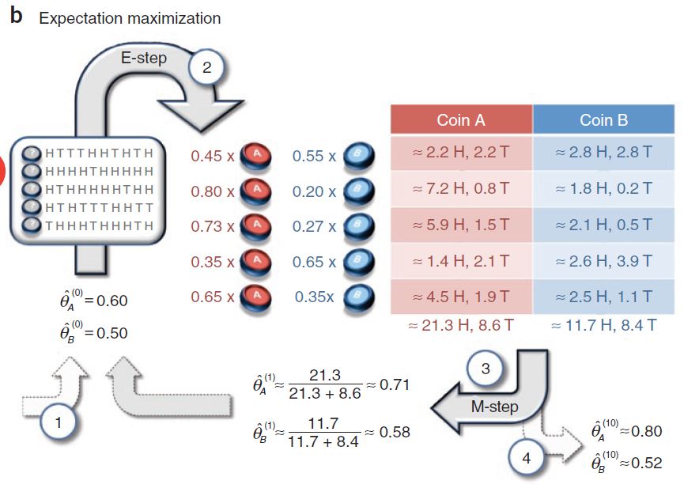
高斯混合模型
Do, C., Batzoglou, S. What is the expectation maximization algorithm?. Nat Biotechnol 26, 897–899 (2008).

